Slide 1

Project management through programming and Best Coding Practice
- with R and STATA practice
Xian Zhang

Slide 2
Context
1. Program Management: setup
2. Programming: Primary tools to communicate intentions
3. Practice of tools in 3 stages of programming
4. Practice in Stata and R

Slide 3

Program Management: setup

Slide 4
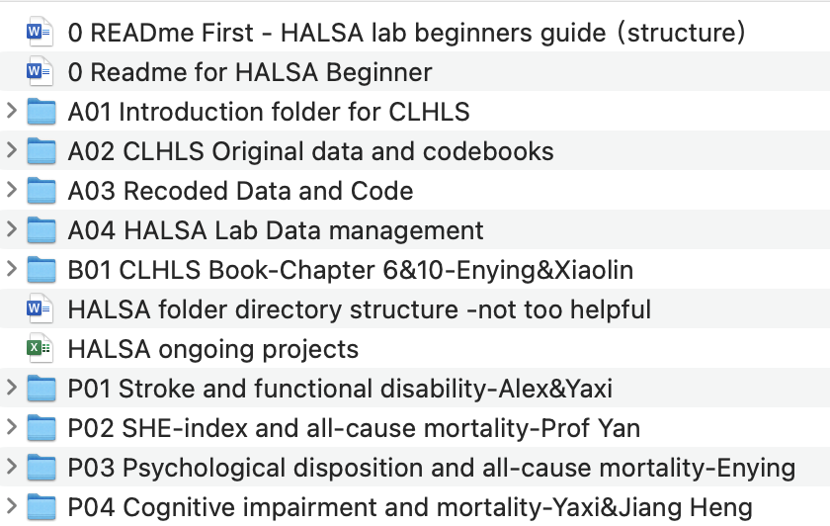
Program setup in Halsa

Slide 5
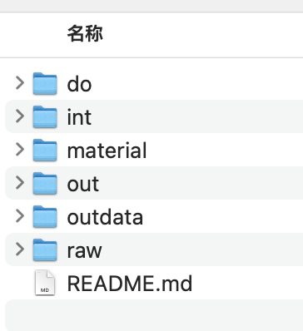
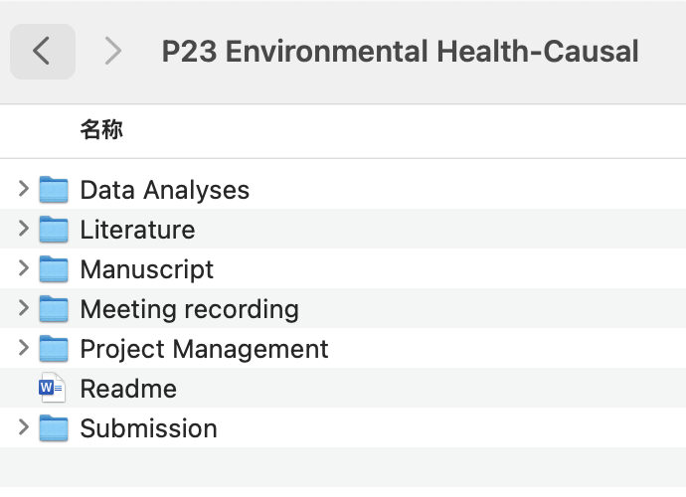
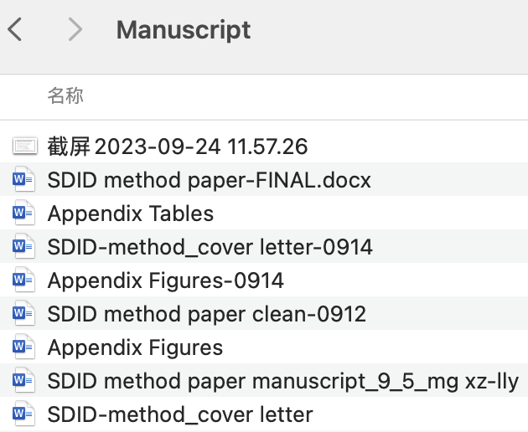
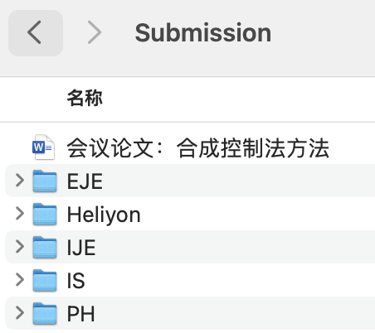
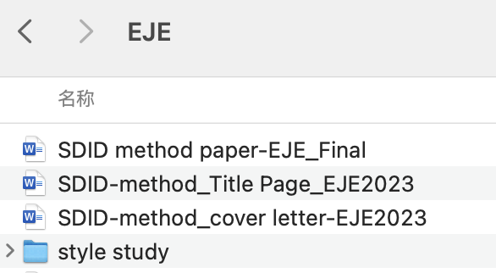
Program setup in Halsa

Slide 6
Program setup in Halsa—STATA

Slide 7
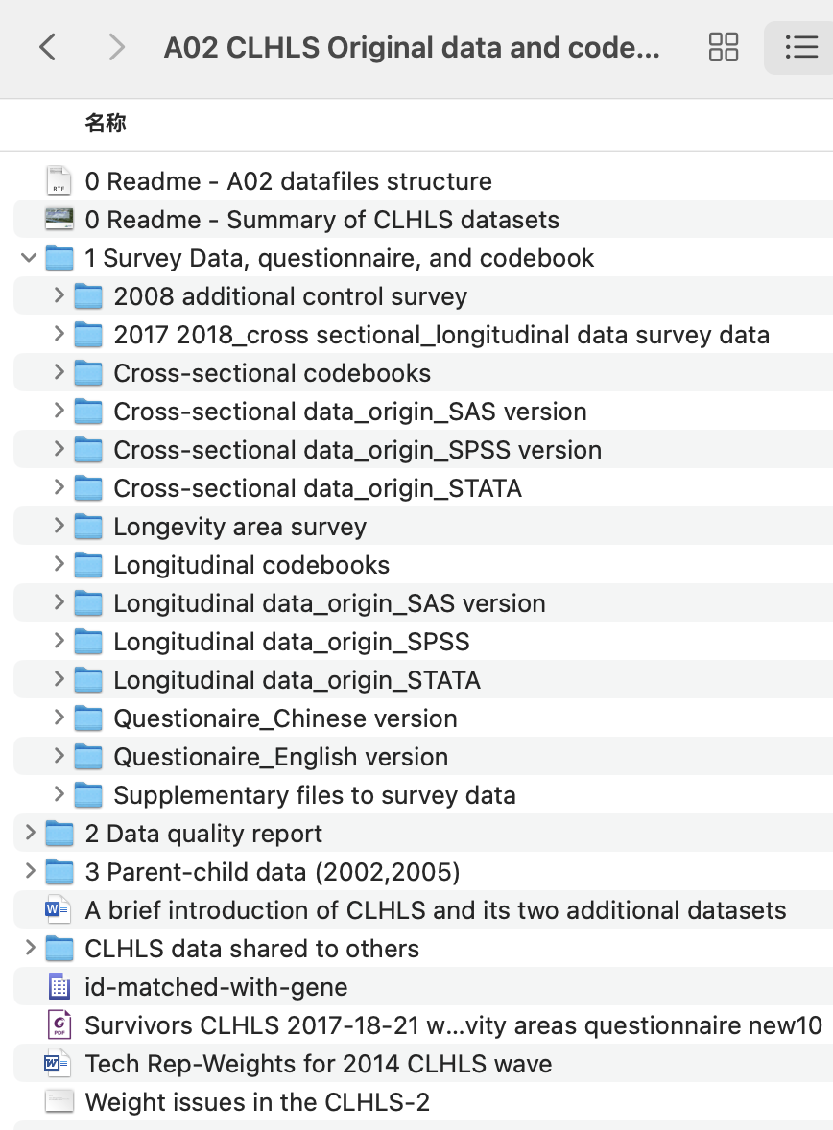
Example—HALSA: raw data
New Raw data:
1. Location:"Box/Healthy Aging - CLHLS - NEW/A02 CLHLS Original data and codebooks/1 Stata/1 Survey Data, questionnaire, and codebook/Longitudinal data_origin_STATA"
2. Difference:
- combine the 14-18 follow up data with all waves
- fixed survival outcomes (47 individual in total)

Slide 8
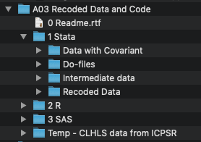
Example—HALSA:
New coded data and code:
Location: Box/Healthy Aging - CLHLS - NEW/A03 Recoded Data and Code/1 Stata/"

Slide 9
Programming: Primary tools to communicate intentions

Slide 10
Primary tools to communicate intentions in programming:
Explanation:
Documentation
Comments
Variable names, constants, expressions and subroutines
*Readability:
Vertical Alignment
Indentation

Slide 11
Explanation: Documentation
*Program Header: placed at the top of the program using several comment lines to summarized the project and track change.
Read.me file: provide the audience with a view of your project and help them to get a quick start of your project.
Codebook: explain the variables to be used in the analyses

Slide 12
Explanation: Read.me file
Motivation: problems it solved, research question it studied
Usage: how to get start with the project
Development of the project.

Slide 13
Explanation: Codebook
Name
Clear definition
For numerical variables, given the range of the variables and related explanation, especially for missing value
For categorical variables, give the explanation for each category.
Data source
* example

Slide 14
Explanation: Comments
Start each class with an accompanying comment that describes what it is for and how it should be used.
Start each function with a comment describing use of the function.
Only comment tricky, non-obvious, interesting or important parts of your code throughout implementation.

Slide 15
Variable names, constants, expressions and subroutines
Variable names should be descriptive enough not to require commenting.
If it is difficult to describe the variables in their names, provide a brief comment at declaration or add labels.

Slide 16
Stage of Programming

Slide 17
Stage of Programming
Before you start coding
During coding
After you finish your work

Slide 18
Before you start coding
Documentation: Program Header
*Program Setup
*Direction Setup
*Version Control
*Package

Slide 19
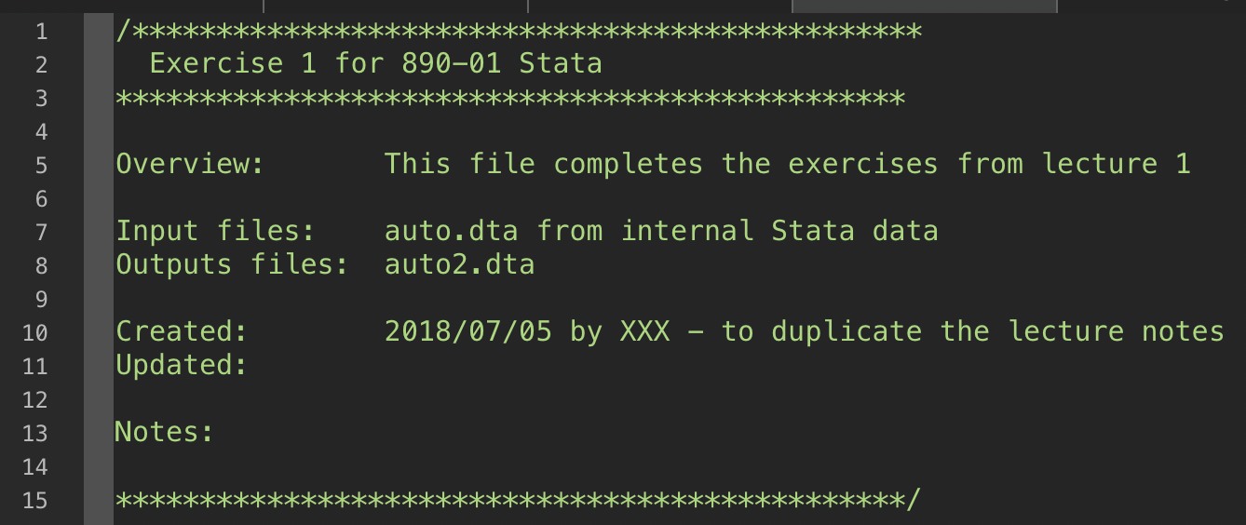
Documentation: Program Header

Slide 20
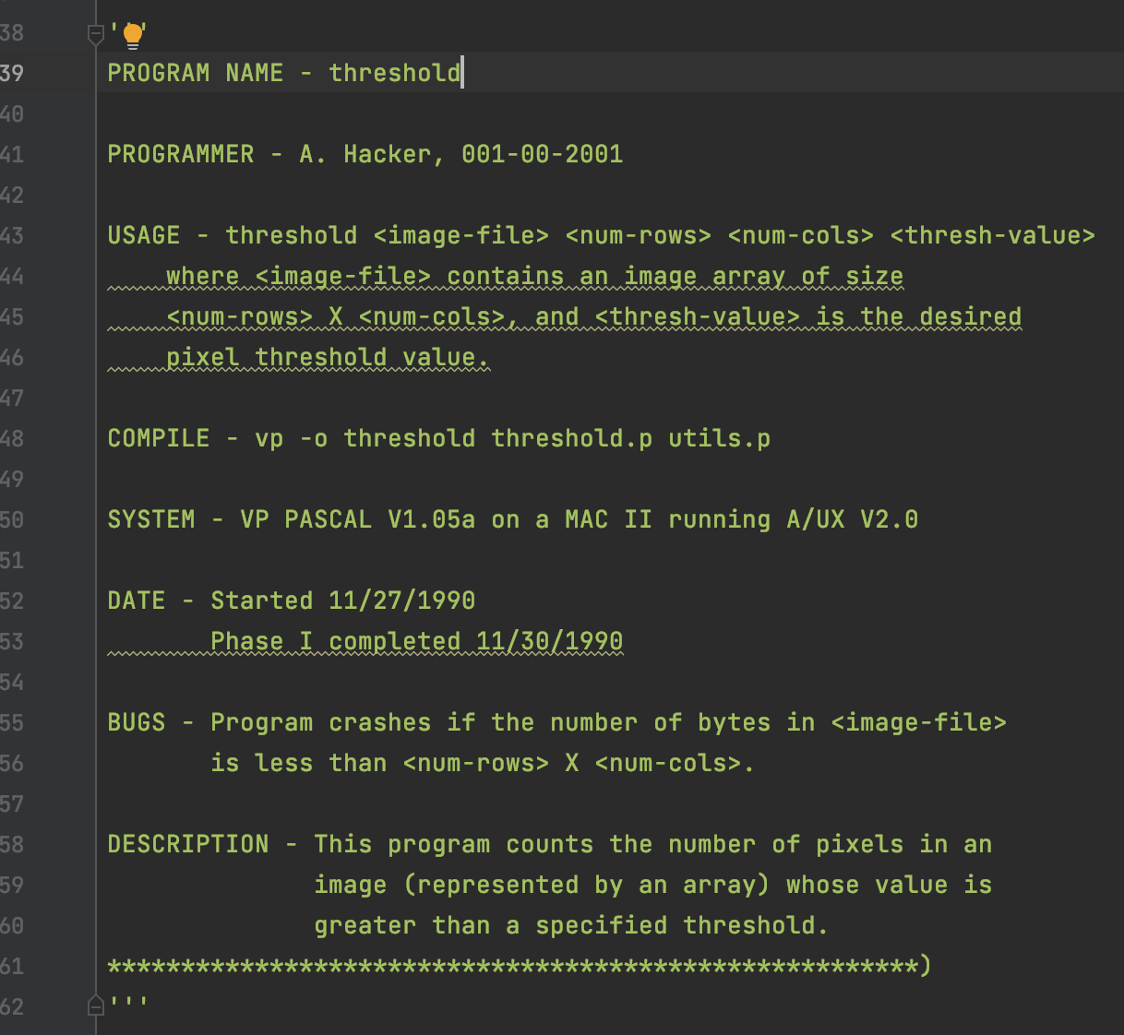
Documentation: Program Header

Slide 21
During coding
*Vertical Alignment
*Indentation
*Syntax: White Space
*Comments
Naming: general rules

Slide 22
Naming: general rules
A good rule of thumb for identifiers in procedural programs (as opposed to object-oriented programs) is to use verb-noun combinations for function identifiers and use noun or adjective-noun combinations for constant and variable identifiers. If a function name requires two verbs or two nouns to fully describe the function, it should probably be split into separate functions.
Rules established by usage:
The first letter of a function or variable name is always in lowercase: setFilled().
The names x and y should only be used to describe coordinates.
The names i, j, and k should only be used as variables in for loops.

Slide 23
After you finish todays’ work
Documentation
Summarize the problem you faced with
Add Reference if needed
*Output
Code
Data

Slide 24
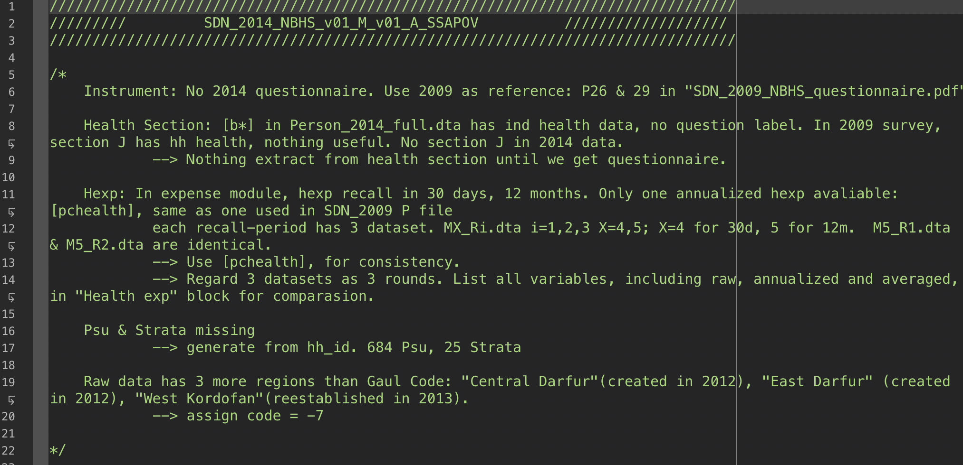
Documentation

Slide 25
STATA practice
By Xian Zhang

Slide 26
Before you start coding
Use single do files to organize
Program Setup
Direction Setup

Slide 27
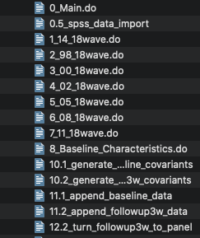
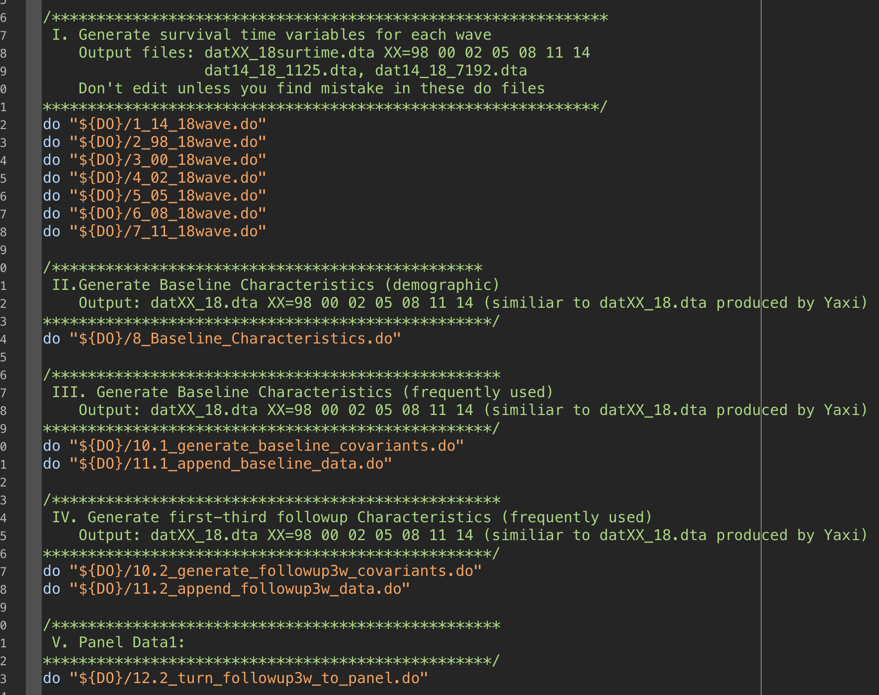
Main do files to organize

Slide 28
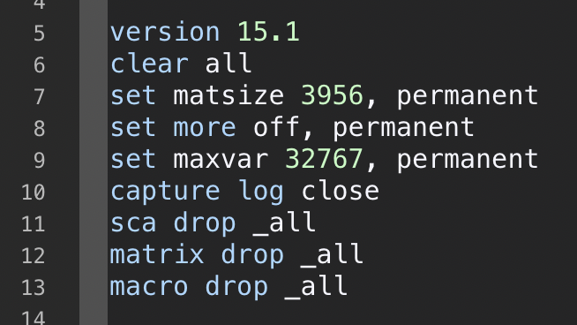
Program Setup: Stata

Slide 29
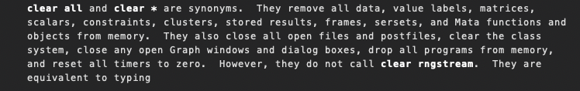
Program Setup: Stata
set matsize sets the maximum matrix size,
Tell Stata to pause or not pause for --more-- messages

Slide 30
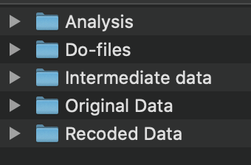
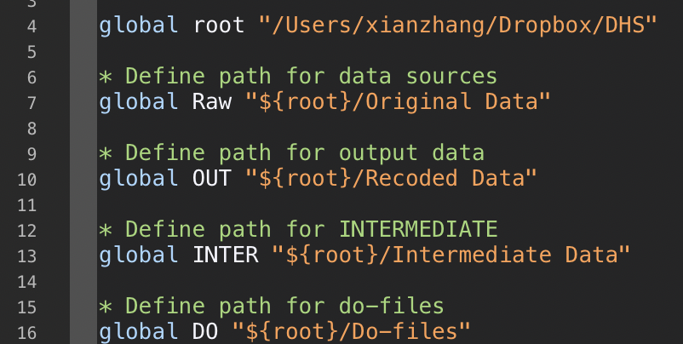
Direction Setup: Stata

Slide 31
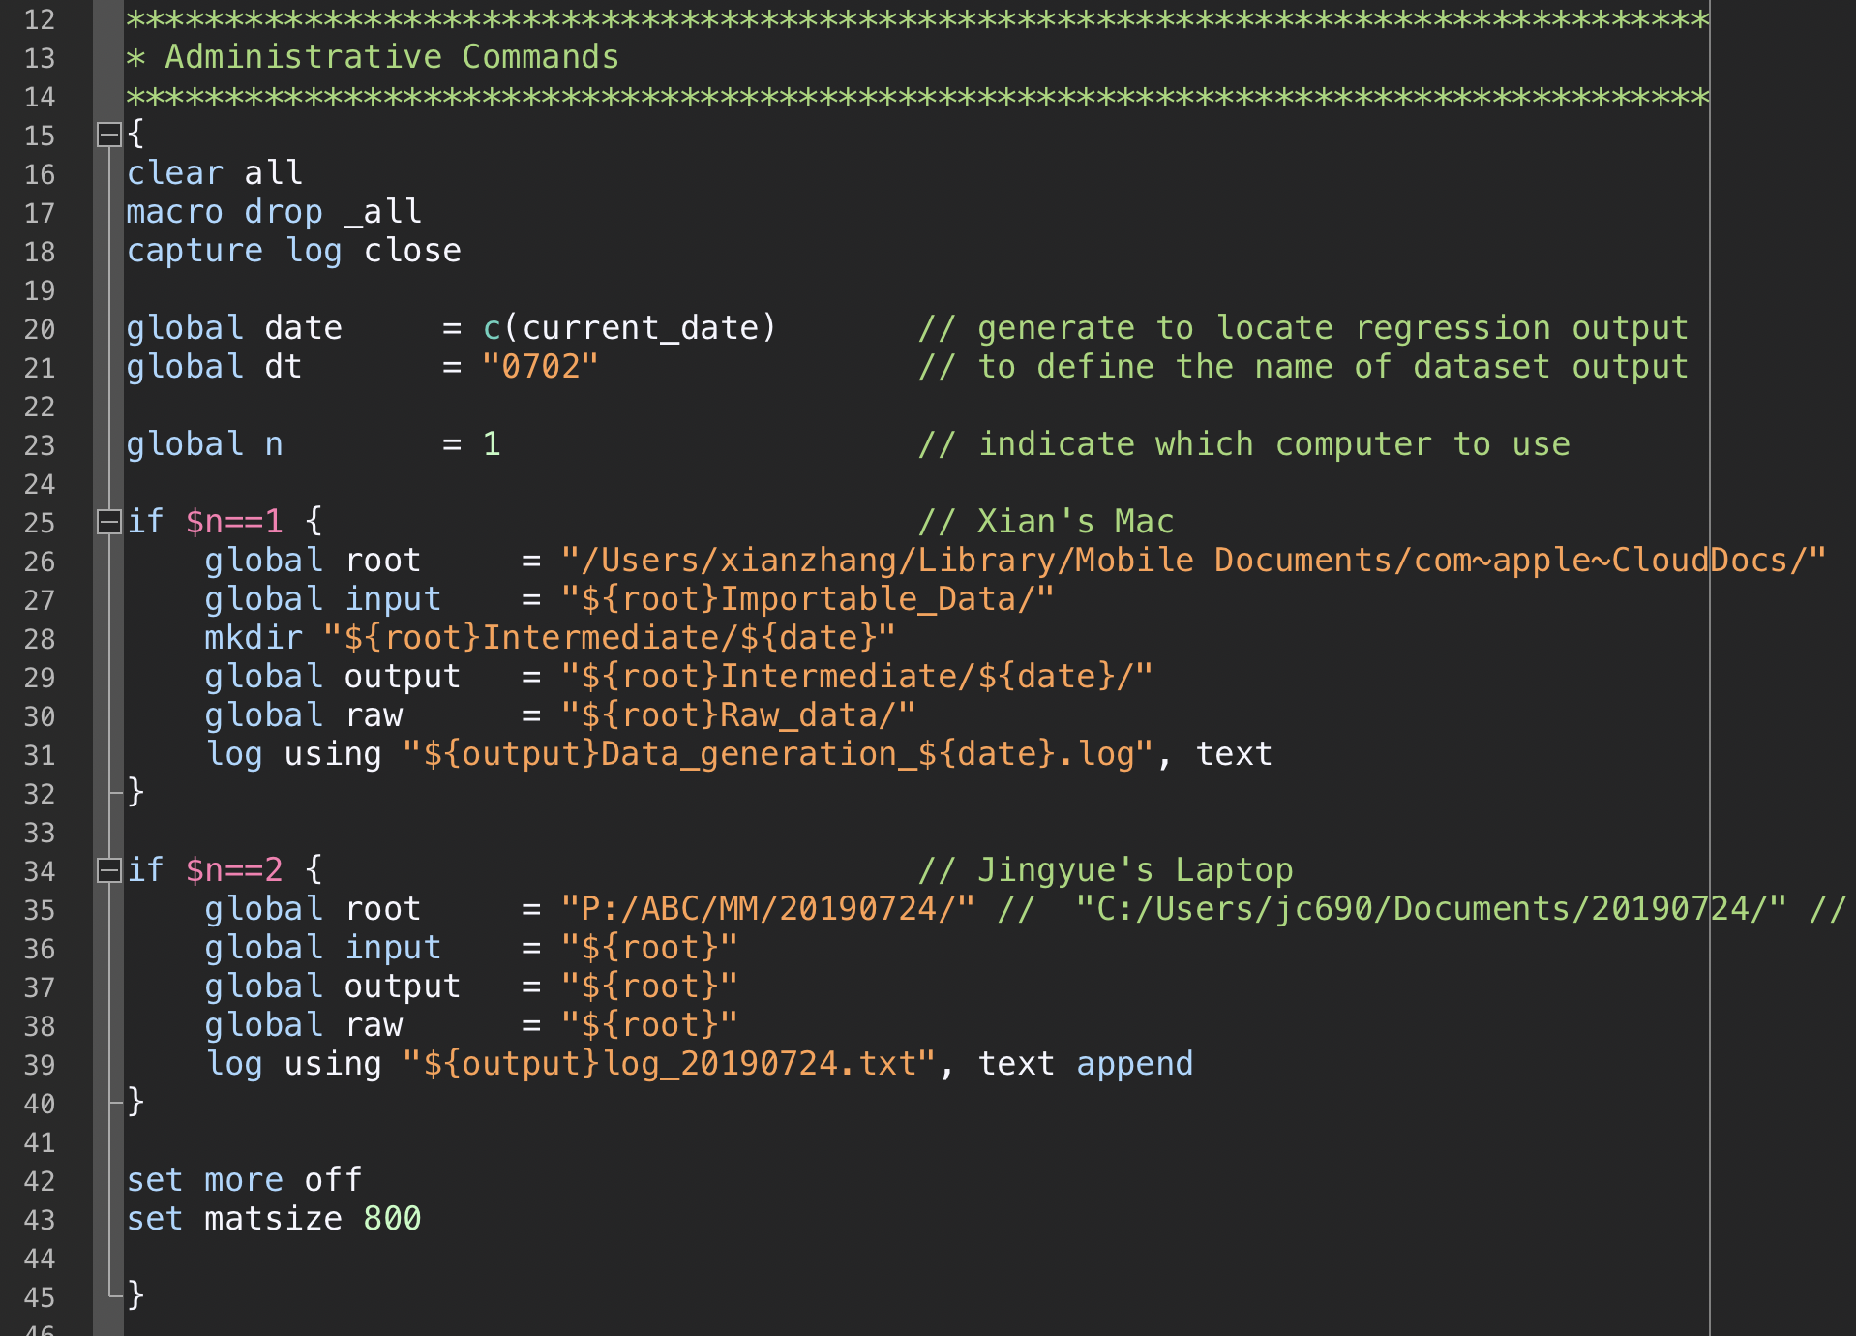
Direction Setup: Stata
! If you are cooperating with others on the same do files with frequent exchange.

Slide 32
During coding
Vertical Alignment
Indentation
Syntax: White Space
Comments
Naming

Slide 33
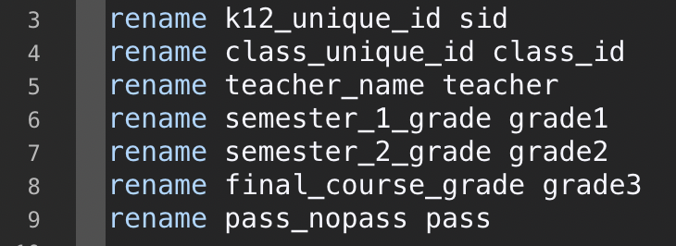
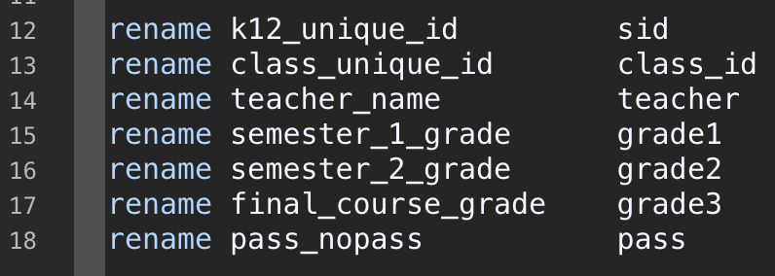
Vertical Alignment

Slide 34
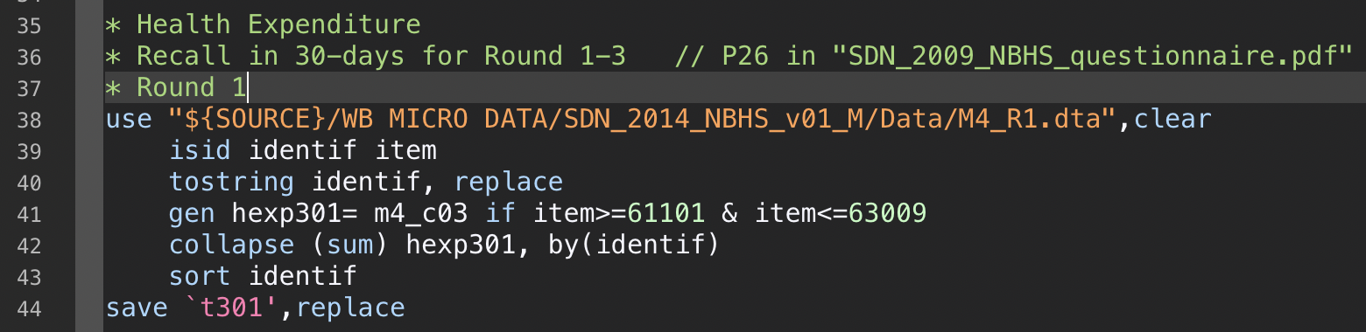
Indentation: recommended in Stata

Slide 35
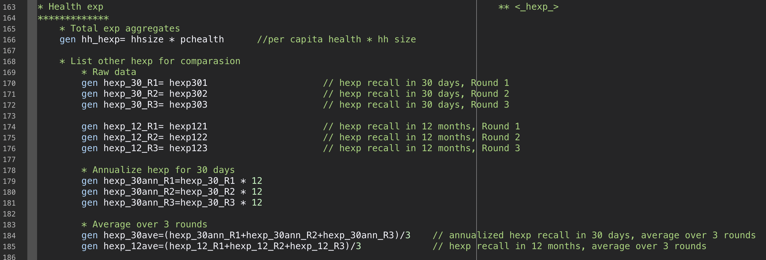
Indentation: recommended in Stata

Slide 36
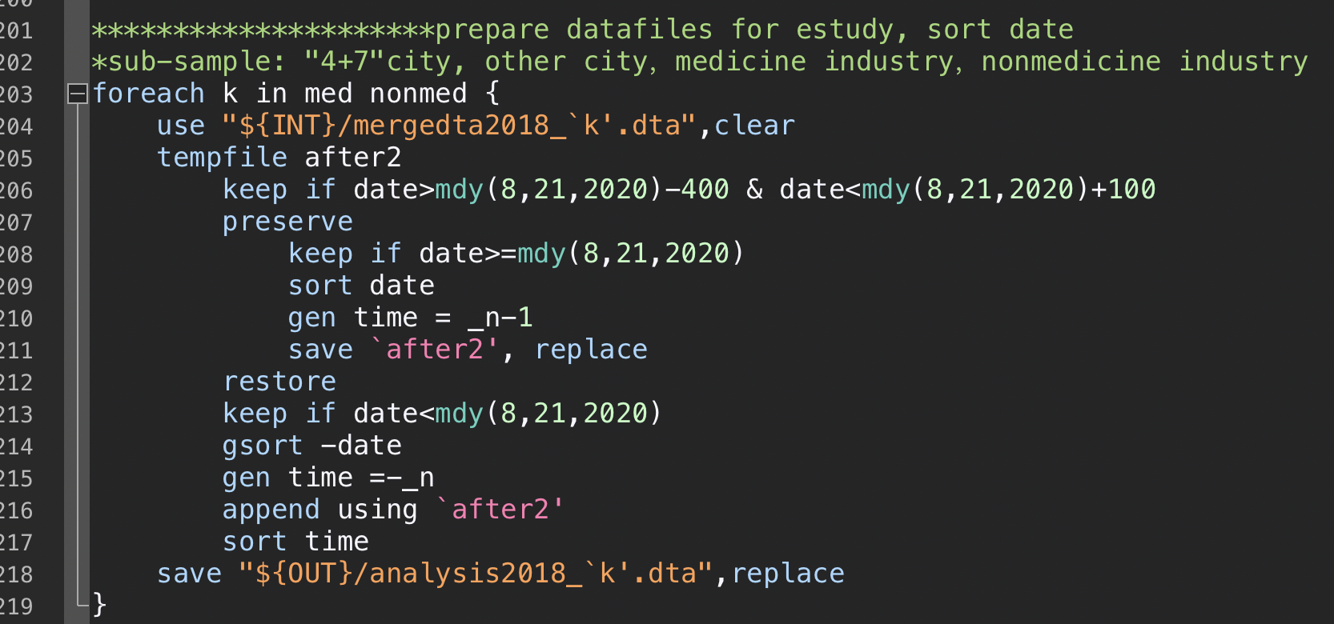
Indentation: recommended in Stata

Slide 37
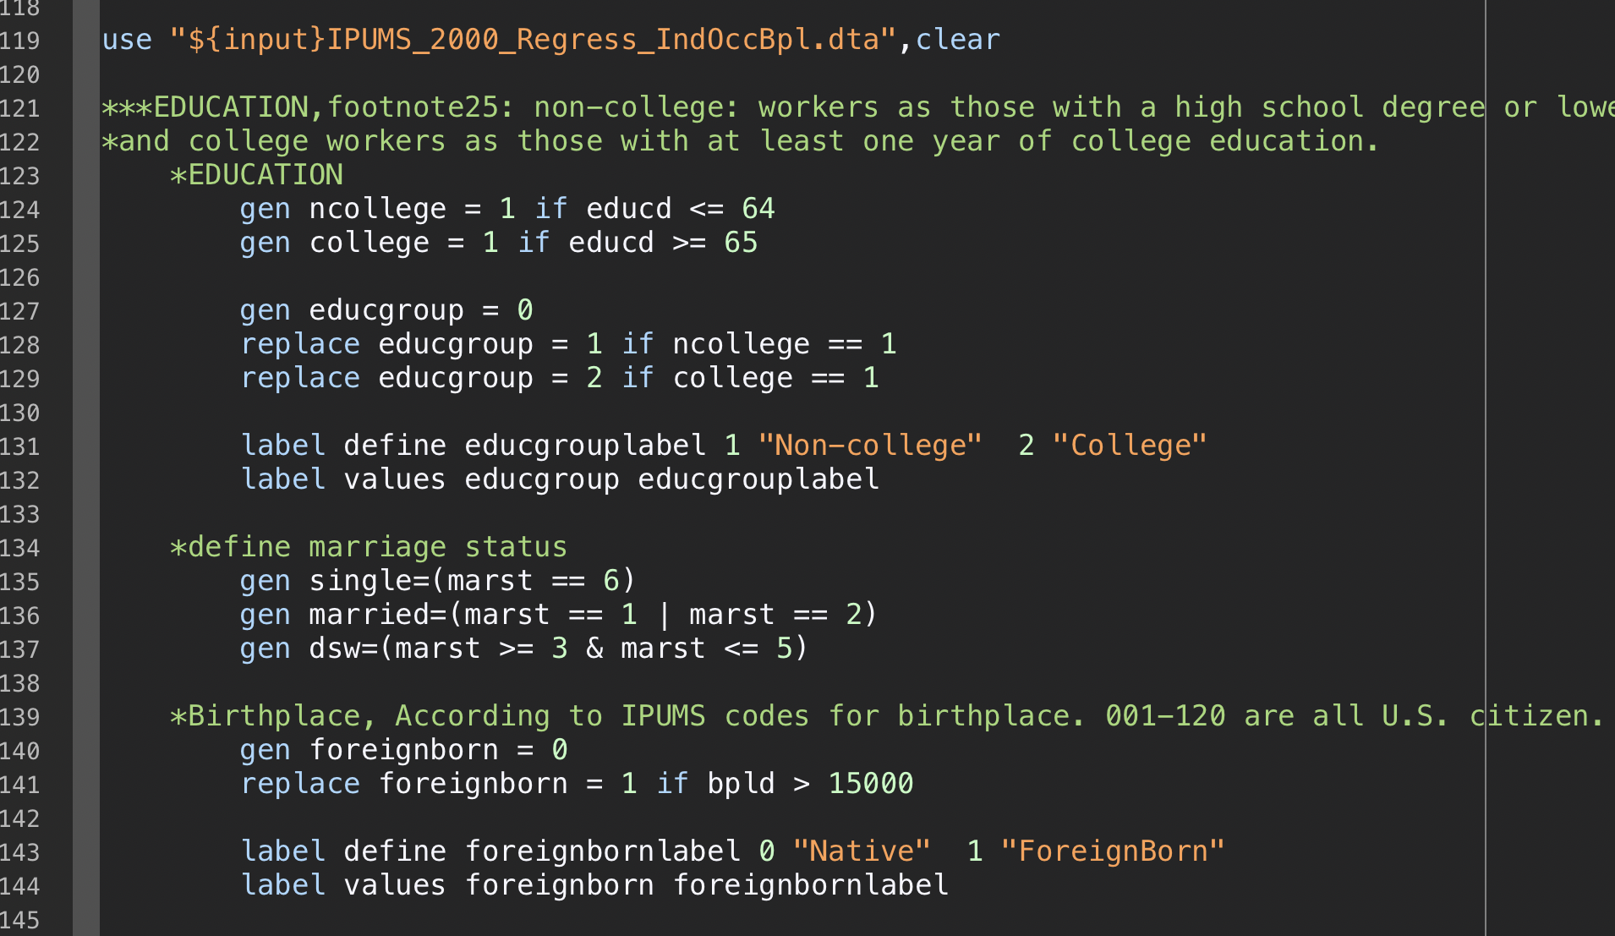
Syntax: White Space
White space is meaningless to compilers, but should be used consistently to improve readability.

Slide 38
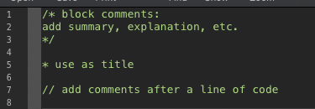
Comments: Stata

Slide 39
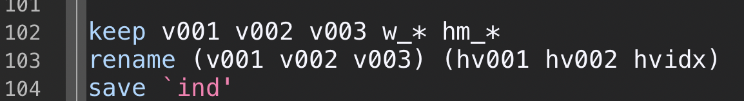
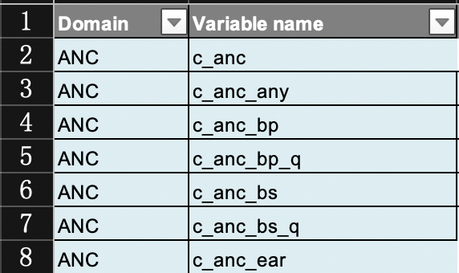
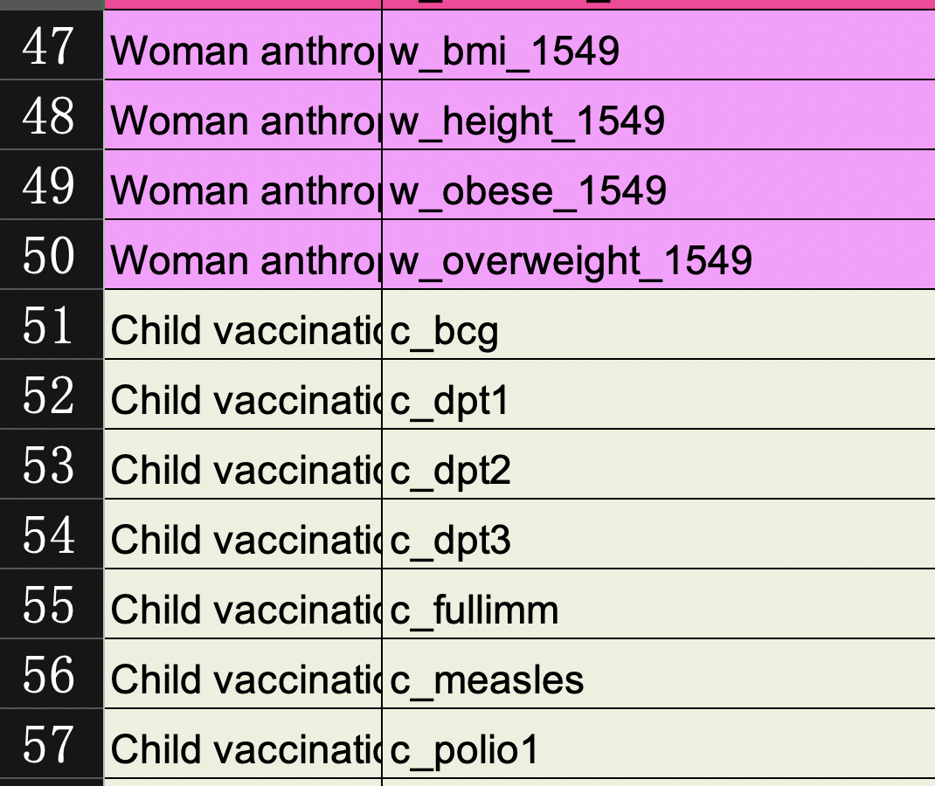
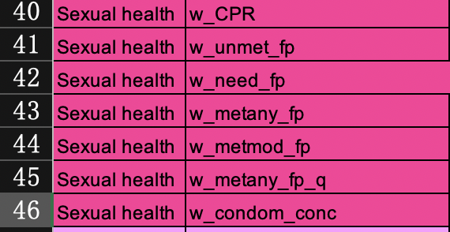
Naming
subgroup_context_subgroup

Slide 40
After you finish todays’ work
Output
Code

Slide 41
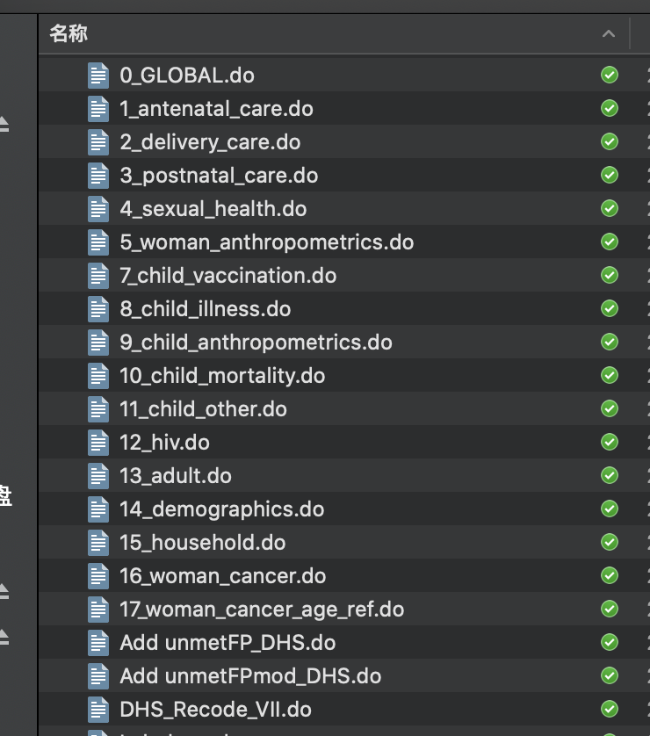
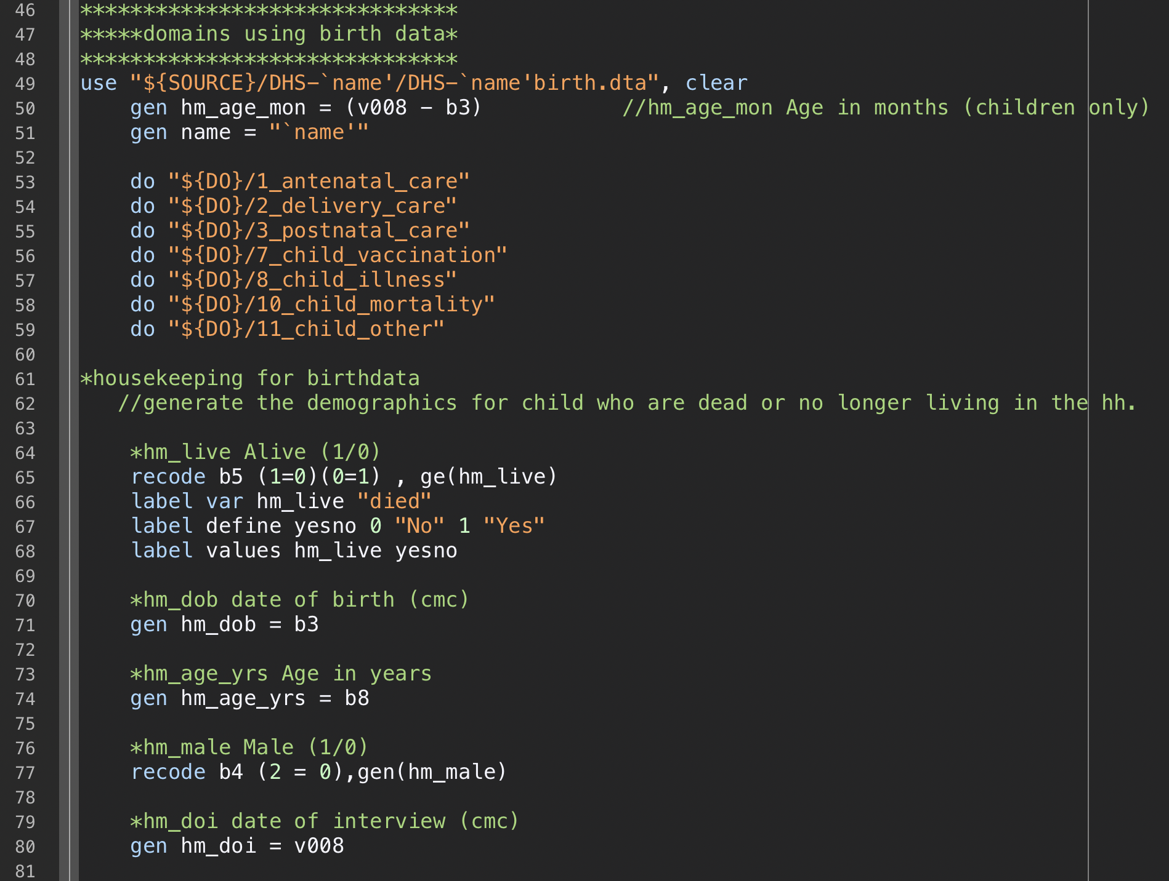
Output: code

Slide 42
R practice
*please watch the tutorial video provided by Zhengting

